Slide 1


Shannon entropy calculation for statistical distribution of decimal digits of Pi number
Professor name: DR.Ali Mehri
Student name: Saeed Mahmoudi
Noshirvani University of Technology

Slide 2
Contents …
01
Entropy in physics
02
Jensen-Shannon divergence
03
Decimal sequence of pi
04
GUI Programing & Parallel computing
05
Calculation and result
1/23

Slide 3
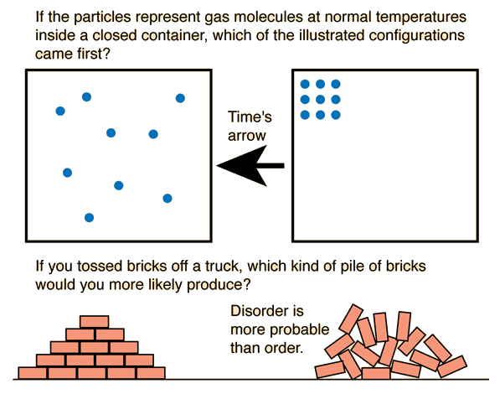
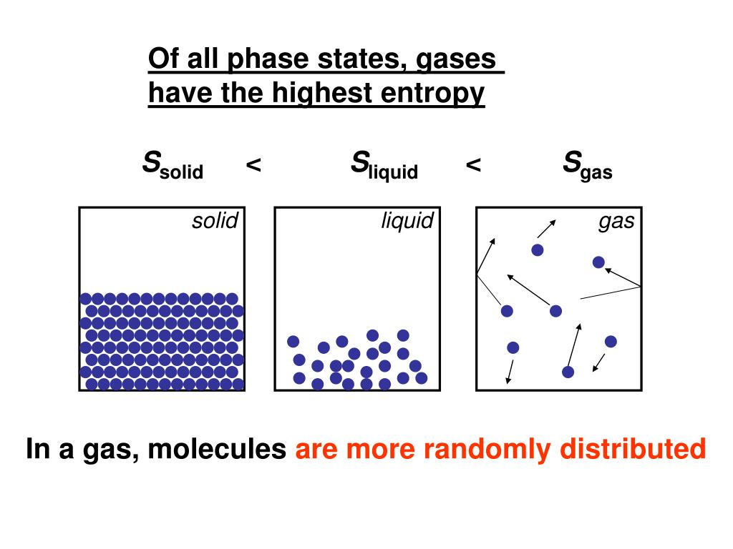
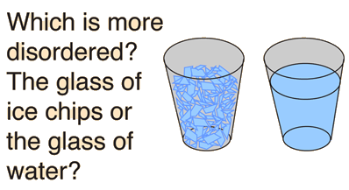


Entropy in physics
Entropy ….
Entropy is a measure of the randomness or disorder of a system.
Entropy definition
disorder system
ordered system
Disorder is more probable than order
Entropy
Which more is disordered ?
$$S=k_{b} \ln{Ω}$$
Sours:
link1
2/23

Slide 4

What is Shannon entropy ?
Shannon entropy,
or more generally information entropy
What ?
Shannon Entropy formula
So, what does entropy mean?
$$H=−\sum_{i=1}^{n}{\left(\frac{count_{i}}{N}\right)\log_{2}\left(\frac{count_{i}}{N}\right)}$$
What dose this mean?
Shannon Entropy
the more random a string is, the higher its calculation of “entropy” (or rather randomness).
Source:
links 2
3/23

Slide 5

Jensen-Shannon divergence
1
The Jensen-Shannon divergence is another measure of similarity between two probability distributions. It is based on KL divergence.
information theory
Kullback- Leibler divergence
Jensen-Shannon divergence
2
Kullback- Leibler (KL) Divergence It measures the distance between two probability distributions P and Q over the same random variable x.
Source:
links 3
4/23

Slide 6



Kullback- Leibler divergence
Kullback-Leibler divergence is a method of measuring statistical distance. It is sometimes referred to as "relative entropy".
$$π$$
Kullback- Leibler formula
$$KL(P|\left|Q\right)=\sum{P_{i}\left(x\right) \log\left(\frac{P_{i}\left(x\right)}{Q_{i}\left(x\right)}\right)}$$
Source:
links 3
5/23

Slide 7

Jensen-Shannon divergence
The Jensen-Shannon divergence is a symmetrical and smoothed version of the Kolbeck-Ybler divergence.
$$π$$
Jensen-Shannon formula
$$JSD(P|\left|Q\right)=\frac{KL(P|\left|M\right)+KL(Q||M)}{2}$$
$$M=\frac{p+q}{2}$$
Source:
links 3
6/23

Slide 8

Decimal sequence of Pi digits
What is normal number?
PI is Normal not random
pi
$$π$$
an irrational number
one that continues forever without any repeating pattern
Is pi a normal number ?
When is a decimal number called normal?
Source:
links 4
7/23

Slide 9


Feynman Point
if pi was normal what to happen?
$$π$$
what is in at position 768 in the pi digits?
8/23

Slide 10

Feynman Point
This block of nines is famously called the “Feynman Point”.
$$π$$
What do we want to do?
In order to gather evidence for Pi's normality, one would like to examine as many digits as possible.
Source:
links 5
9/23

Slide 11

Parallel computing
GUI Programing
challenge big data and loss ram
And the challenges we had
10/23

Slide 12
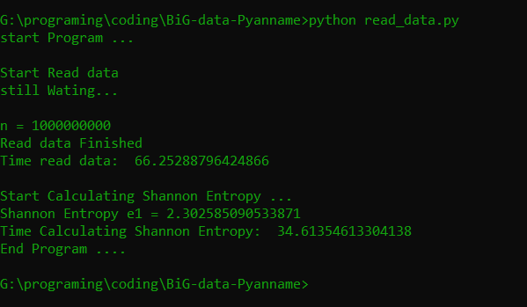
One billion decimal places Pi number
Calculation of
Shannon entropy,
The results
Time to read data = 66.25 second
……..
The Shannon entropy = 2.302
……..
Shannon entropy calculation time = 34.61 second
11/23

Slide 13
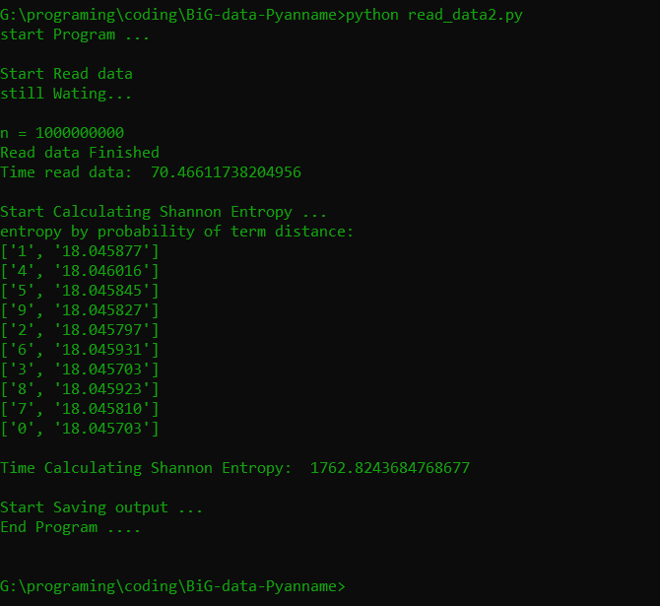
One billion decimal places Pi number
Calculation of
Shannon entropy,
The results
Time to read data = 70.46 second
……..
Jensen-Shannon divergence calculation time = 1762.82 second
12/23

Slide 14
The results
Shannon entropy diagram by the interval of consecutive events of digits, in terms of the length of a word.
In this method, entropy is calculated for the difference between the number interval or the event interval of the counted digits.
13/23

Slide 15
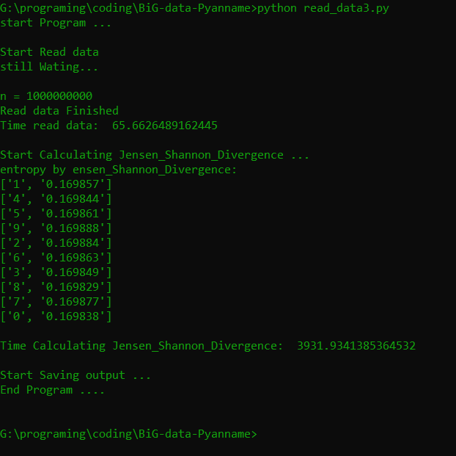
One billion decimal places Pi number
Calculation of
Jensen-Shannon divergence,
The results
Time to read data = 65.66 second
……..
Jensen-Shannon divergence calculation time = 3931.93 second
14/23

Slide 16
The results
Jensen-Shannon divergence diagram by consecutive event spacing of digits, in terms of word length.
15/23

Slide 17
One million decimal places pi number
Calculation of
Shannon entropy,
A series of more interesting calculations were performed, for a number of digits up to a million digits, we considered the length of the two vertices, then calculated the entropy of Shannon, the result being the opposite graph.
16/23

Slide 18
One million decimal places pi number
Calculation of
Shannon entropy,
17/23

Slide 19
One million decimal places pi number
Calculation of
Jensen-Shannon divergence,
18/23

Slide 20
One million decimal places pi number
Calculation of
Jensen-Shannon divergence,
19/23

Slide 21
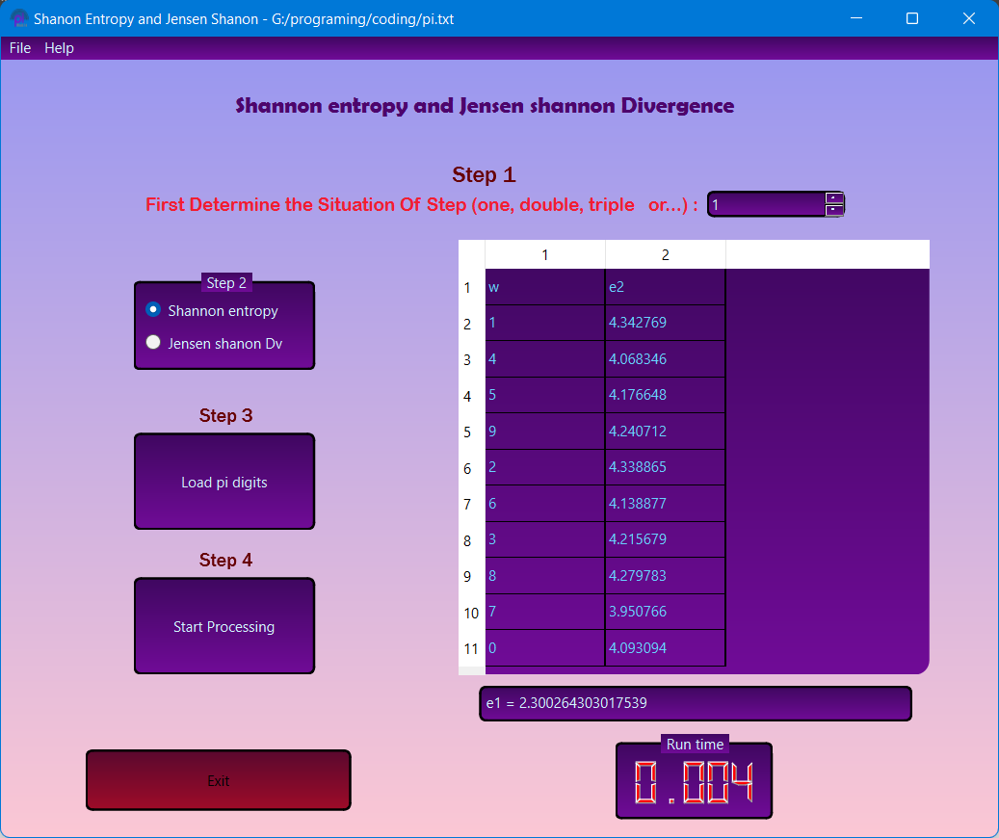
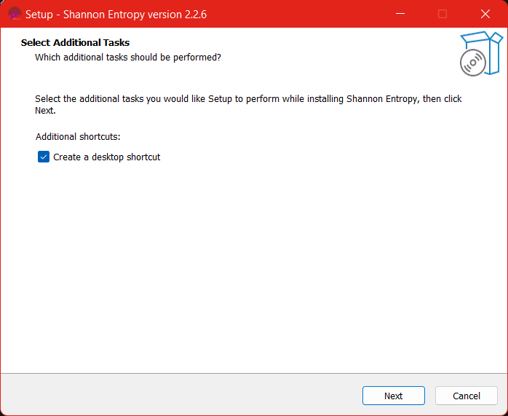
The result of a modern GUI for calculating
entropy
20/23

Slide 22
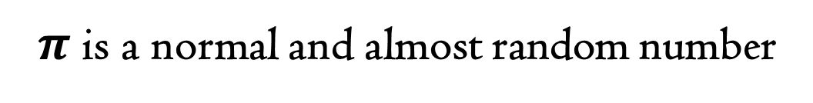
Conclusion
$π$is a normal and almost random number
21/23

Slide 23
THANK YOU
For your attention

